Slide 1
Introduction to Life Support Systems
Matthew Katterman

Slide 2
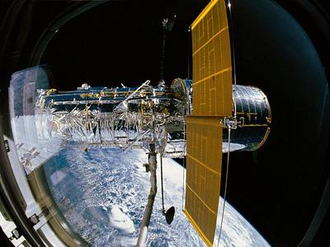
NASA Environmental Control & Life Support System (ECLSS)
Will experiment with science concepts related to systems that support astronauts in outer space.
Outer space is inhospitable – doesn’t support life by itself.
ECLSS is a system that provides astronauts with the atmosphere to conduct life essential activities on the International Space Station.

Slide 3
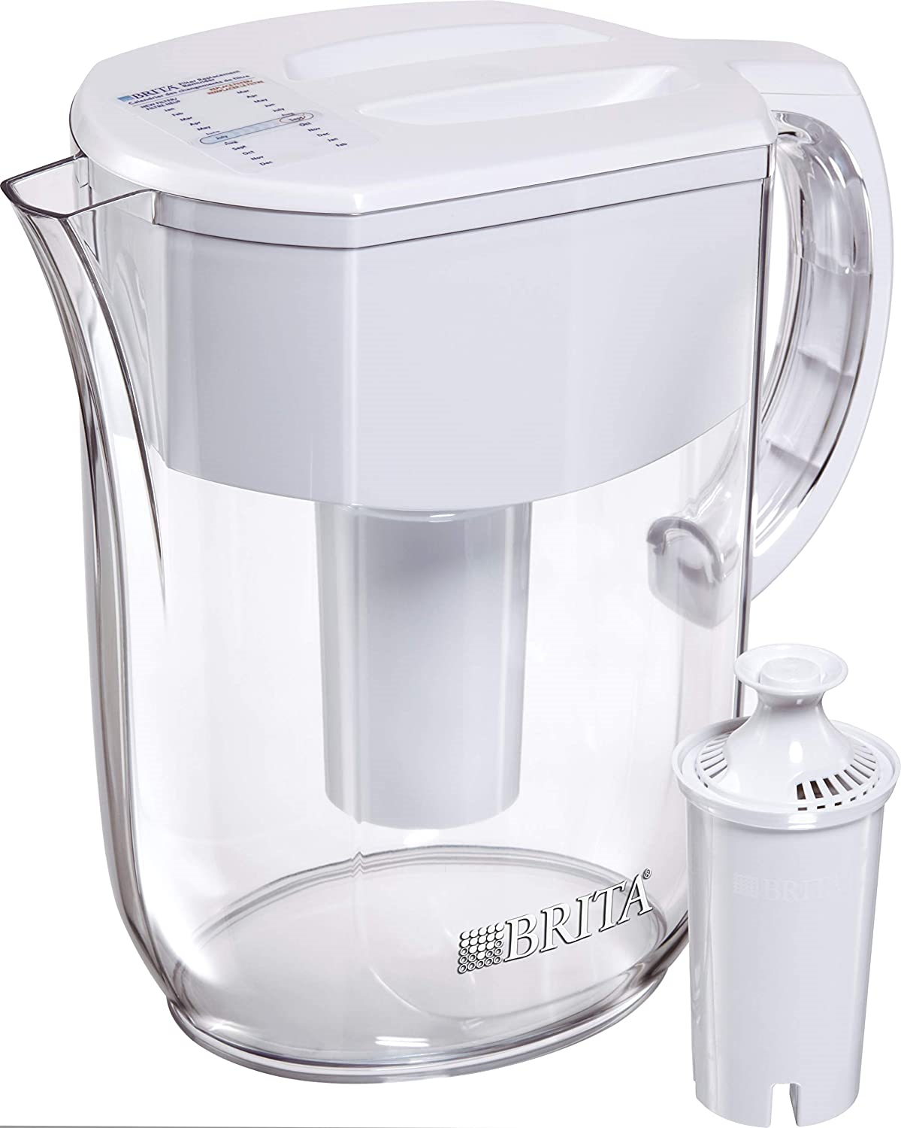
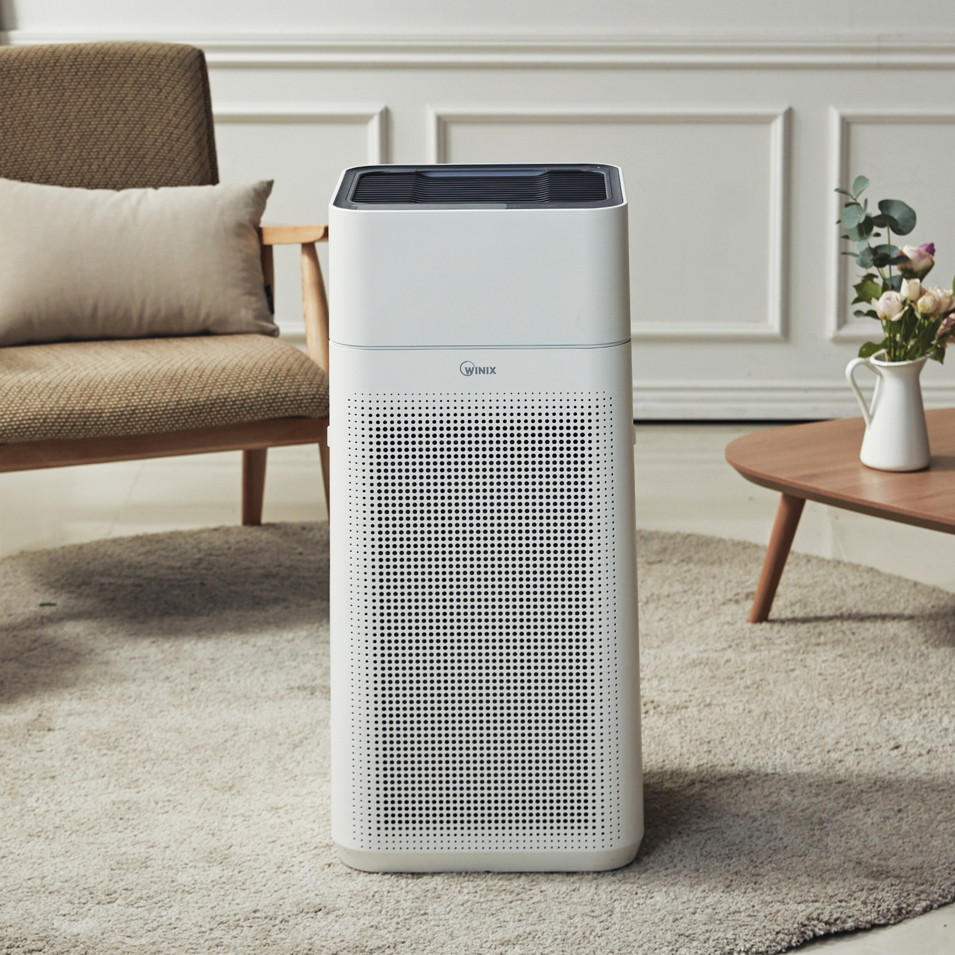
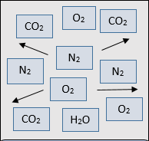
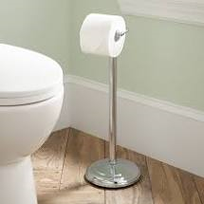
Life Support Systems overall description
The ISS Life Support Systems can be associated with their Earth related system functions.
Water Recovery and
Management – Providing clean potable water and being able to recycle, reuse and conserve it.
Air Revitalization – Ensures that the air you breathe is clean. It should contain no contaminants and low amounts of carbon dioxide.
Atmospheric Control and
Supply – Ensures the right amounts of oxygen, nitrogen and other gases are in the air.
Waste Management – Gives the proper allocation and disposal of human solid wastes (poop).

Slide 4
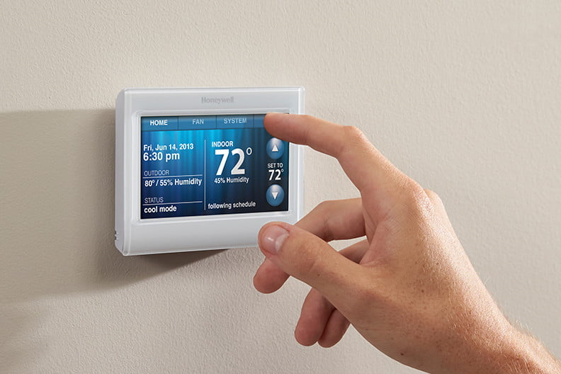
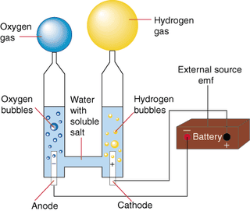
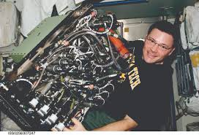
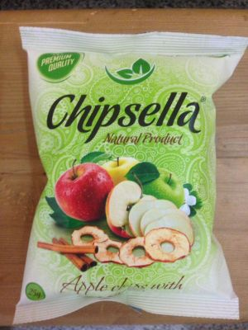
Life Support Systems overall description
The ISS Life Support Systems can be associated with their Earth related system functions.
Temperature and Humidity Control – The proper air temperature and humidity are in the appropriate range similar to indoor places.
Oxygen Generation – You can make oxygen through the process of Electrolysis. Electrical energy creates both the gases of Hydrogen and Oxygen from water.
Sabatier System – The input of carbon dioxide and hydrogen creates water and methane through a reactor.
Food Storage and Preparation – Ensures that your foods are properly prepared to be stored and then hydrated to be later eaten.

Slide 5
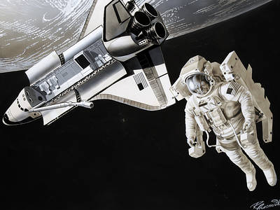
Life Essential Processes & Activities
What essential life processes (things that you have to do to live) and activities do astronauts require so that they can work in outer space?
(Can you guess the 6 that I picked out?)

Slide 6

Life Support Systems for Breathing
REQUIREMENTS and LIFE SUPPORT SYSTEMS to create an environment for proper breathing.
Requirements :
Life Support Systems :
1. Right amount of oxygen and nitrogen in the air.
2. The ability to create your own supply of oxygen.
3. Removal of carbon dioxide from the air.
4. Making sure there is clean air with no contaminants.
Atmospheric Control and Supply
Oxygen Generation
Air Revitalization
BREATHING

Slide 7
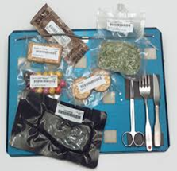
Life Support System for Eating
REQUIREMENTS and LIFE SUPPORT SYSTEM needed for Eating on the space station.
Requirements :
Life Support System :
Food must be dehydrated and properly packaged on Earth.
The food must be properly stored on the space station.
A system is needed to add hot water to hydrate the food.
The food must be kept warm before eaten.
Food Storage and
Preparation
EATING

Slide 8
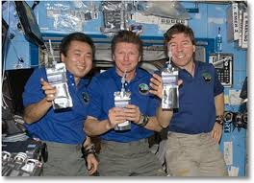
Life Support System for Drinking
REQUIREMENTS and LIFE SUPPORT SYSTEM needed for Drinking on the space station.
Requirements :
Life Support System :
1. Continually providing a clean, potable supply of water for drinking.
2. Properly contain, store and deliver the water to the astronauts.
3. Being able to recycle and reuse the water supply so don’t rely on
Transportation to replenish it.
Water Recovery
and Management
DRINKING

Slide 9


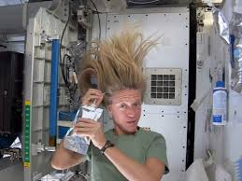
Life Support Systems for Hygiene and Cleaning
REQUIREMENTS and LIFE SUPPORT SYSTEMS needed for having personal hygiene and cleaning.
1. Must have a clean, potable supply of water that is properly contained and delivered to astronauts.
2. Need a way to recycle and replenish that supply of water needed for cleaning.
3. Need ways to conserve those supplies of water.
Water Recovery and Management
Temperature and Humidity Control
PERSONAL HYGIENE

Slide 10
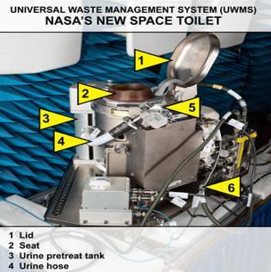
Life Support Systems for Bathroom use
REQUIREMENTS and LIFE SUPPORT SYSTEMS needed for going to the bathroom on the Space Station.
1. Process and dispose of human solid wastes appropriately.
2. Recycle and reuse water from urine.
Waste Management
Water Recovery and
Management
BATHROOM FUNCTIONS

Slide 11
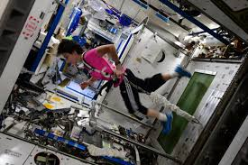
Life Support Systems for Exercising
REQUIREMENTS and LIFE SUPPORT SYSTEMS needed for exercising on the Space Station.
1. Right amount of oxygen
and other gases.
2. Air is clean with no
Contaminants.
3. Has proper temperature
And humidity.
1. Oxygen Generation
2. Temperature and
Humidity Control
3. Air Revitalization
EXERCISING

